Slide 2
SERVER LESS
Maksym Vasyshchev

Slide 3

ABOUT ME
Maksym Vasyshchev
Architect @ SoftServe
Specialize in cloud solutions

Slide 4
AGENDA
?
WHAT IS SERVERLESS
BENEFITS
PITFALLS
PATTERNS
PLAYERS

Slide 5

BUT FIRST, WHY SERVERLESS?

Slide 6
GARTNER HYPE CYCLE
Notes:
maturity and adoption of technologies and applications
Innovation Trigger: A potential technology breakthrough kicks things off. Early PoC stories and media interest trigger significant publicity. Often no usable products exist and commercial viability is unproven.
Peak of Inflated Expectations: Early publicity produces a number of success stories — often accompanied by scores of failures. Some companies take action; many do not.
Trough of Disillusionment: Interest wanes as experiments and implementations fail to deliver. Producers of the technology shake out or fail. Investments continue only if the surviving providers improve their products to the satisfaction of early adopters.
Slope of Enlightenment: More instances of how the technology can benefit the enterprise start to crystallize and become more widely understood. Second- and third-generation products appear from technology providers. More enterprises fund pilots; conservative companies remain cautious.
Plateau of Productivity: Mainstream adoption starts to take off. Criteria for assessing provider viability are more clearly defined. The technology's broad market applicability and relevance are clearly paying off.

Slide 7
SERVERLESS HYPE CYCLE
currently on rise
2-5 years to plateau
need to know about strengths
beware of pitfalls
Serverless
PaaS

Slide 8

SO WHAT IS SERVERLESS?

Slide 9
WHAT IS SERVERLESS
https://readwrite.com/2012/10/15/why-the-future-of-software-and-apps-is-serverless/
The phrase “serverless” doesn’t mean servers are no longer involved. It simply means that developers no longer have to think that much about them.

Slide 10
IS IT FUNCTIONS?
Historically, was used to describe two overlapping areas:
Backend as a Service (BaaS)
Functions as a Service (FaaS)
It can also include:
Storage
Messaging
Application services
* it is functions and much more!

Slide 11
BACKEND AS A SERVICE
BaaS
A cloud service model in which web and mobile applications significantly or fully rely on storage and application services managed and provided by vendor.
You write reach client – vendor provides and manages backend.
Backend means:
database and storage
user authentication
push notifications
remote update
Notes:
BaaS was originally used for rich clients, web and mobile. It enables developers to concentrate on their application and have storage layer served by 3rd-party.

Slide 12


FUNCTIONS AS A SERVICE
FaaS
A cloud service model in which application logic is run in stateless compute containers fully managed by vendor.
You write backend code, vendor manages and executes it.
No management of your own server systems or long-lived server applications required.
Notes:
Absence of long-lived server apps is what distinguishes FaaS from containers.
Samples are: AWS Lambda, Azure Functions, Google Cloud Functions

Slide 13
SERVERLESS NOW
Currently, serverless architecture is usually
based on FaaS
event-driven
combined with storage, messaging and application services
But how define serverless?
Notes:
https://serverlessconf.io/
Probably the biggest conference dedicated exclusively to serverless.
Last edition had more than half sessions focused on FaaS and none focused on BaaS only.

Slide 14
SERVERLESS TRAITS
Requires no management of server hosts or server processes
Auto-scales and auto-provisions, based on load
Cost based on actual usage
Performance is defined in terms other than host size/count
Has implicit high availability
By Mike Roberts: https://martinfowler.com/articles/serverless.html
Notes:
This is a great definition from industry experts
Future reading:
https://blog.symphonia.io/defining-serverless-part-1-704d72bc8a32
https://martinfowler.com/articles/serverless.html

Slide 15

BENEFITS

Slide 16
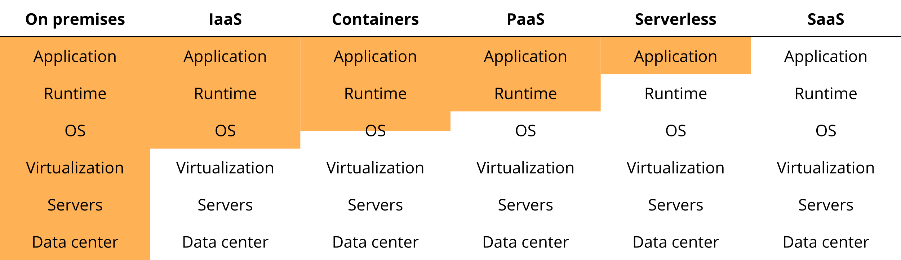
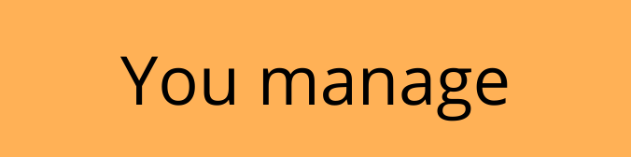
LESS OPERATIONS AND MAINTENANCE

Slide 17
SERVERLESS BENEFITS
Less operations and maintenance
Faster Time to Market
Use vendor’s services
No need to build
Out of the box:
High Availability
Scalability
Resiliency

Slide 18
SERVERLESS BENEFITS
Less operations and maintenance
Lower
operating expenses
Cost based on usage*

Slide 19
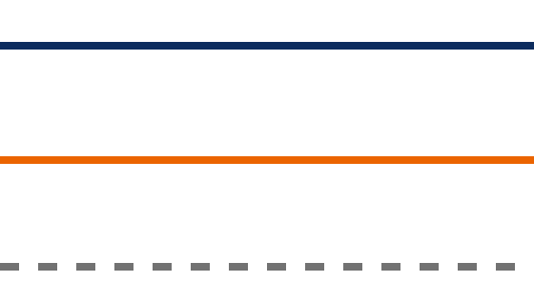
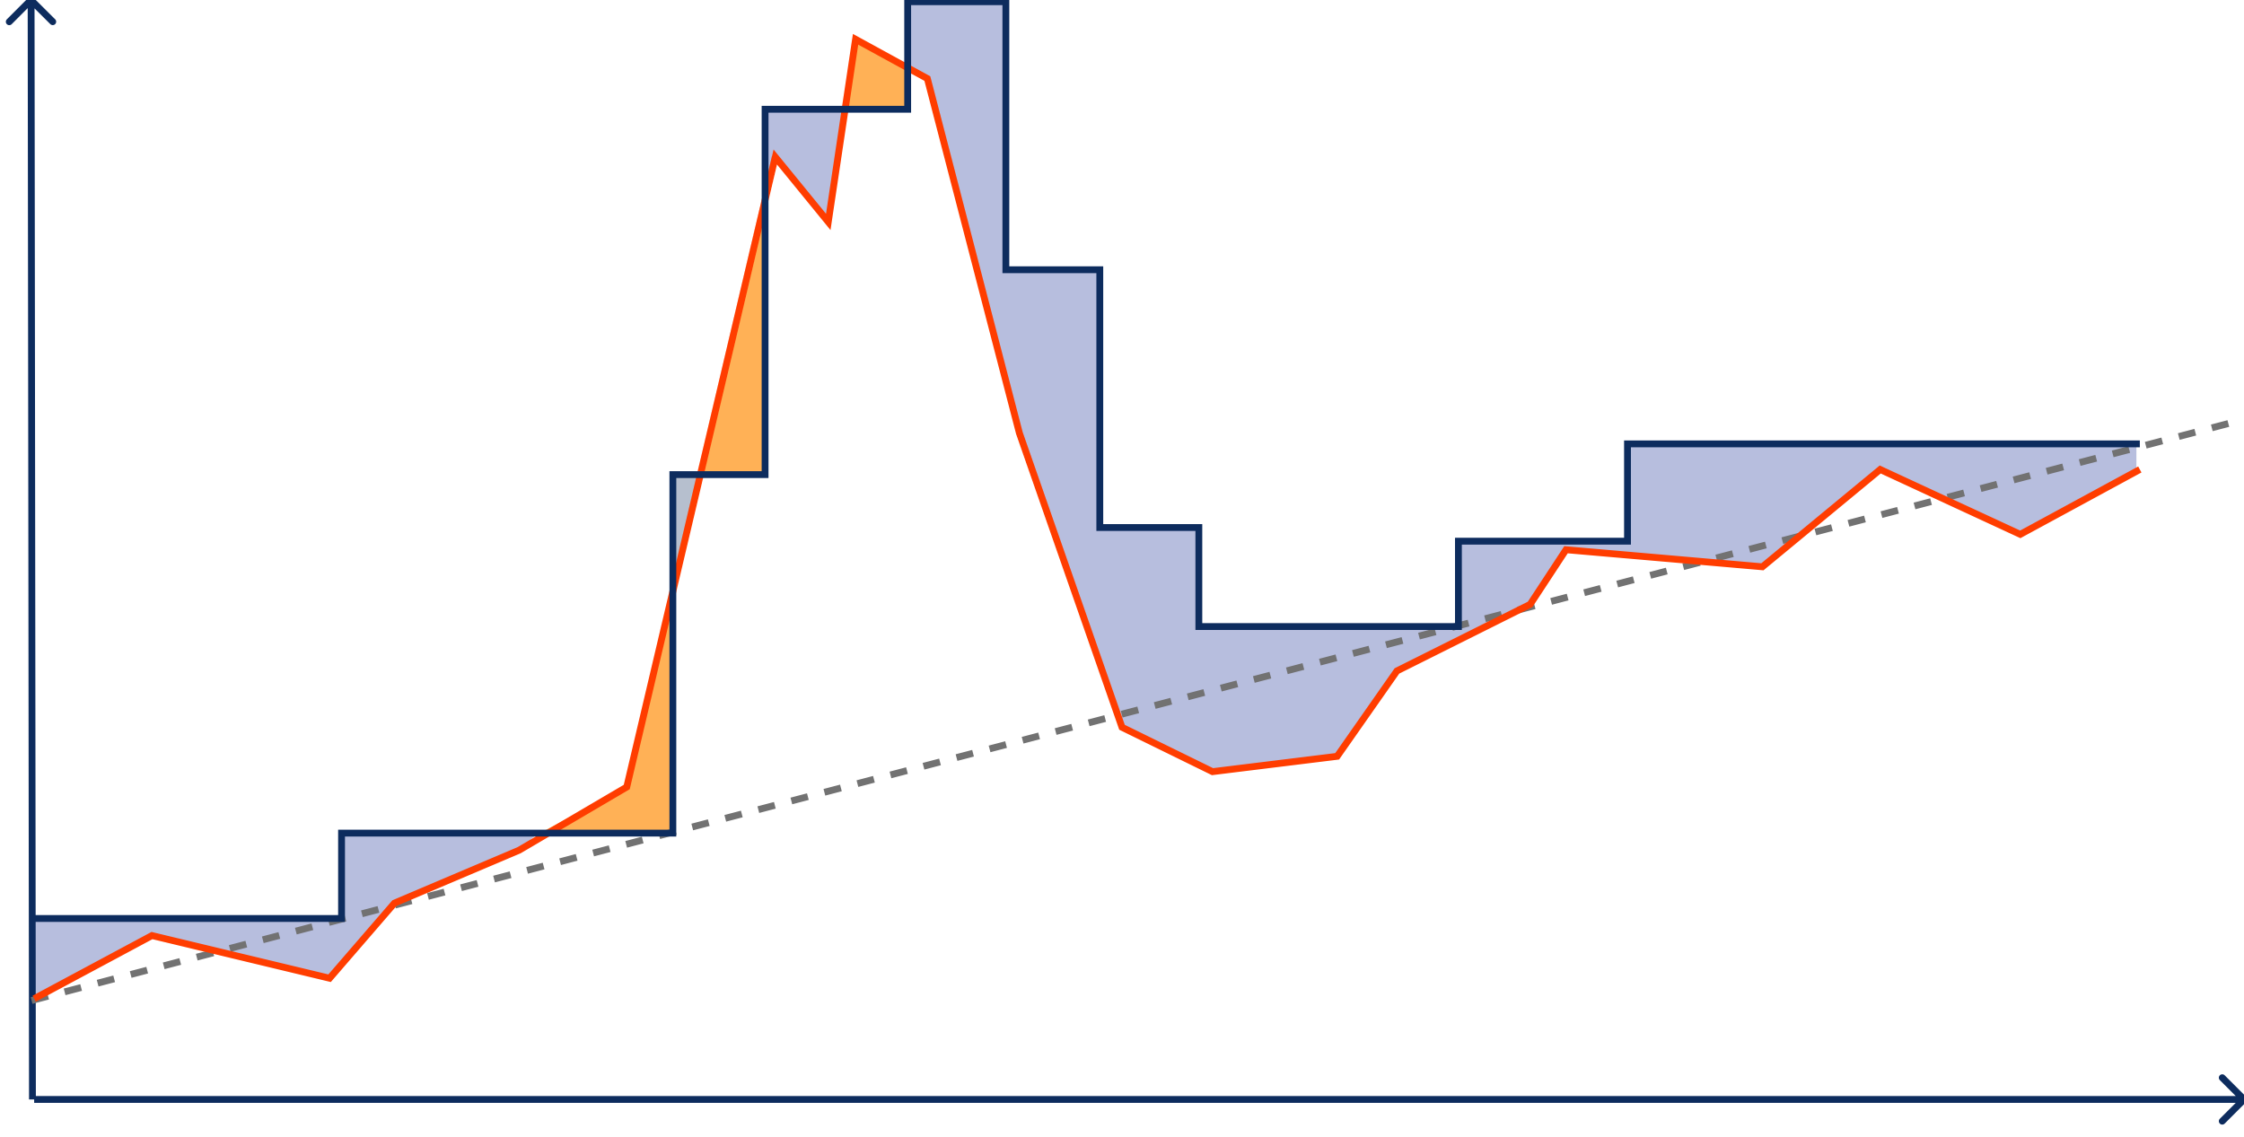
SERVERLESS SCALING
provisioned capacity
denial of service
actual load
predicted load
load
unused capacity
time

Slide 20
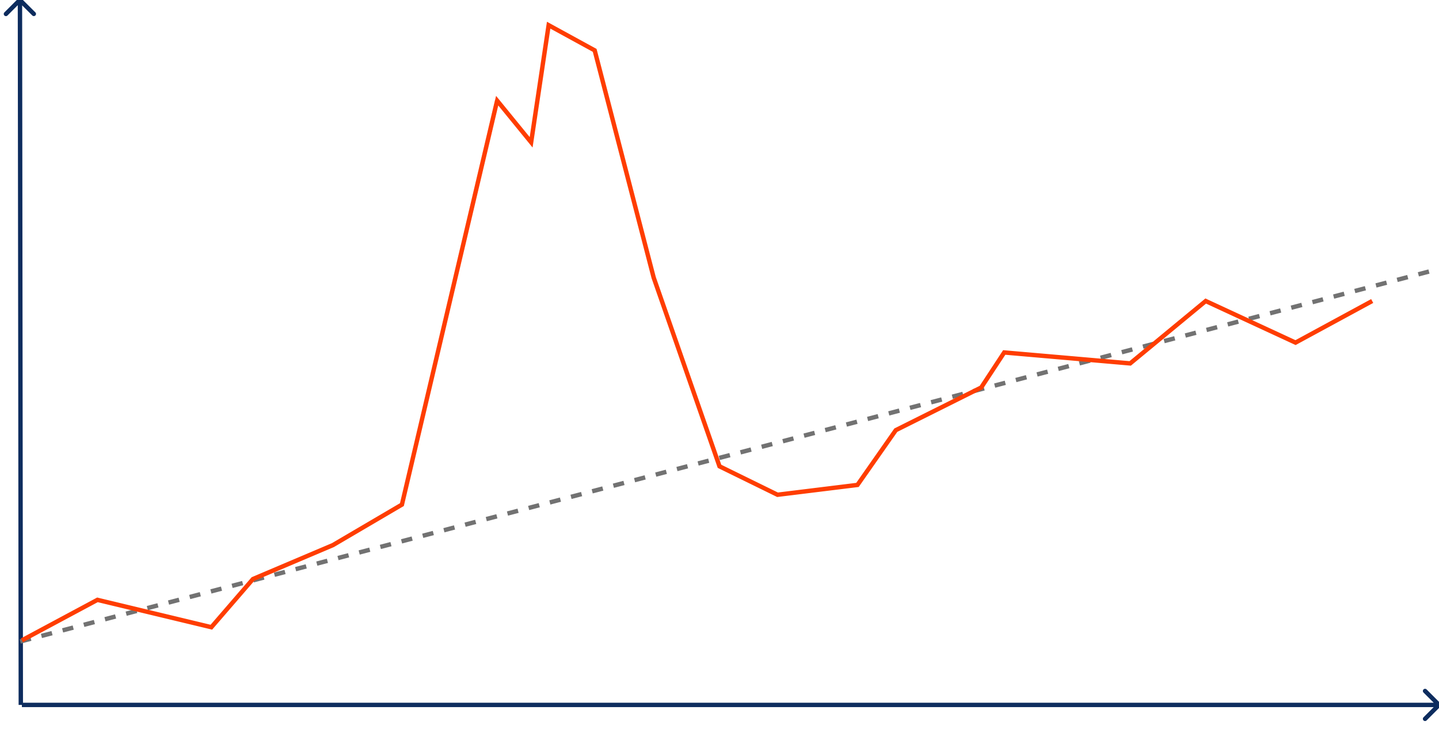
SERVERLESS SCALING
ACTUAL LOAD = PROVISIONED CAPACITY
*scale burst load no problem
load
time

Slide 21
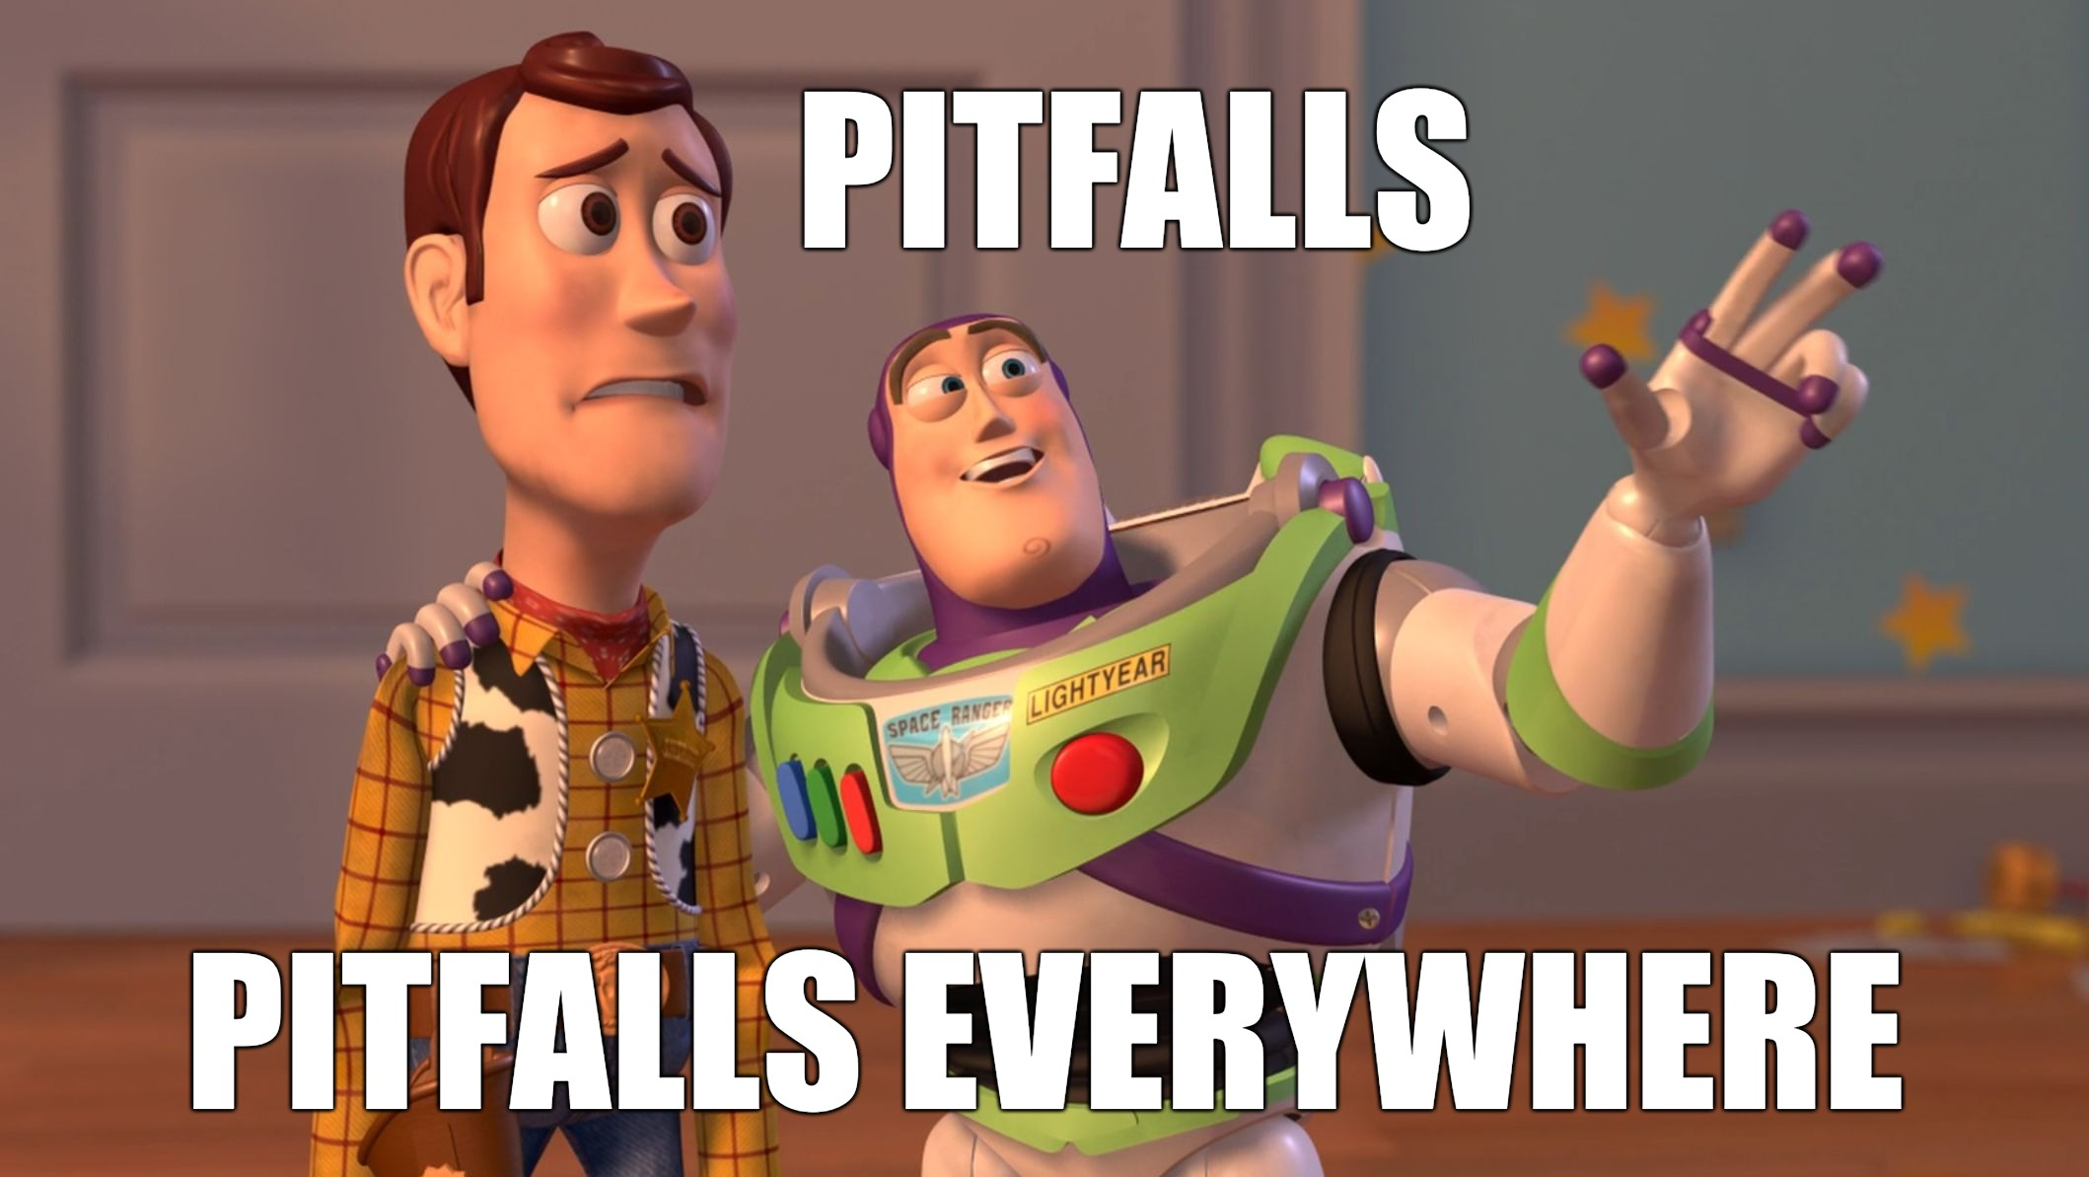

Slide 22
VENDOR LOCK-IN
no standards to be leveraged, vendor’s APIs are different
multi-platform solutions are immature
vendors have different sets of capabilities, which makes migration more complex
Notes:
Using FaaS, application services, messaging and storage from a vendor gives not only faster Time to Market, but also ties to the specific vendor.

Slide 23
VENDOR LOCK-IN
embrace your vendor, use all services
migration vs multi-platform solution
Notes:
Migrating is not expensive, given fast Time to Market of serverless.
make easily migratable, not multi-cloud

Slide 24

COLD STARTS
Time to provision and load a new instance of a function.
Happens when function:
executed first time
shut down due to inactivity
is scaled

Slide 25
COLD STARTS
keep warm
smaller size
faster languages
timeouts and retries
do not use when latency is critical

Slide 26
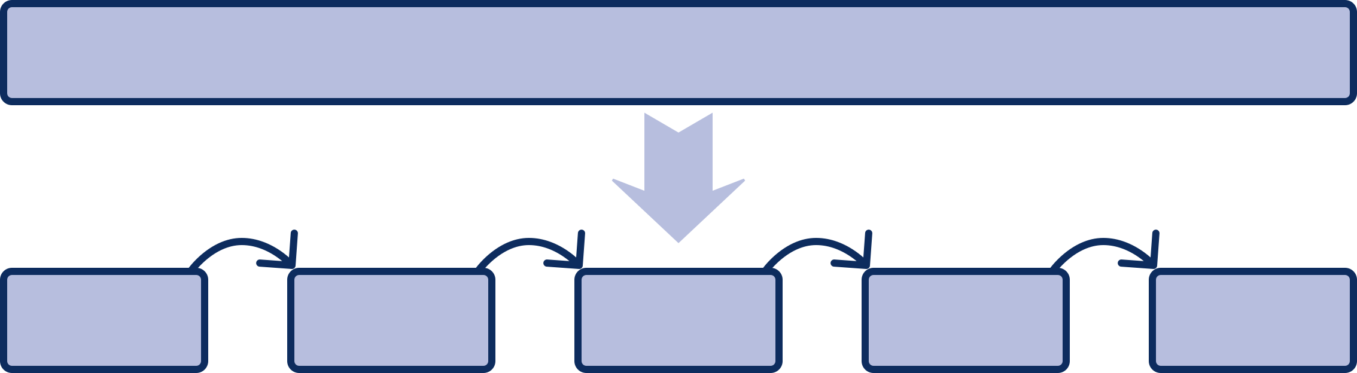
LONG RUNNING
Function running time is limited.
What to do:
break to small steps
AWS Step Functions and Azure Durable Functions
use servers for long stuff and serverless for processing

Slide 27
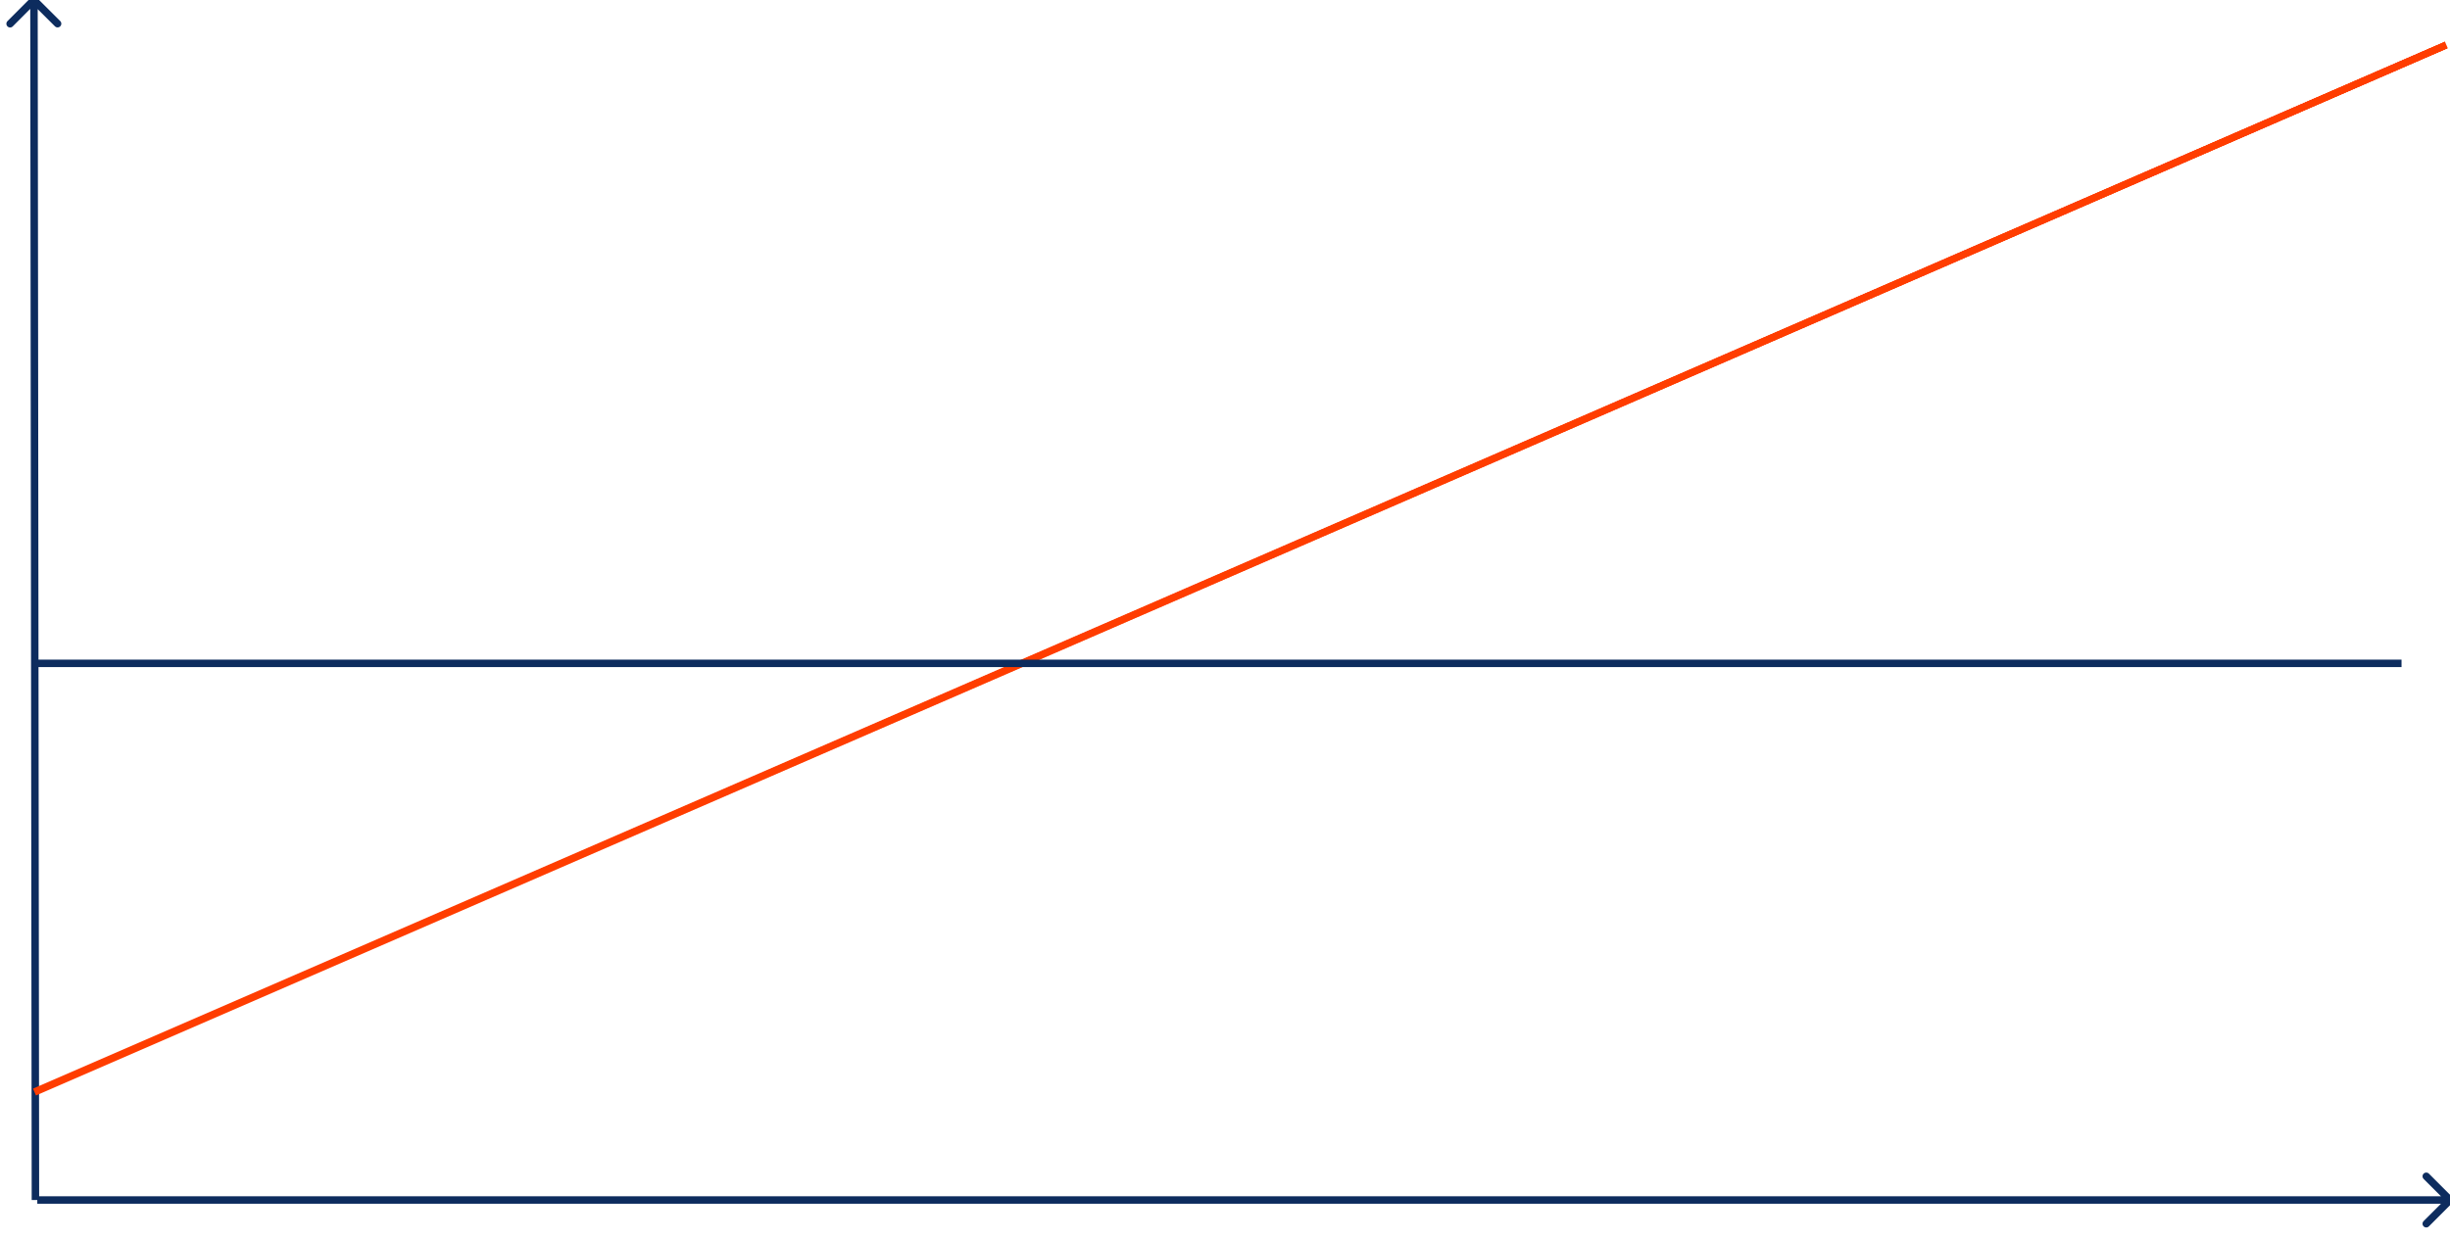

RUNNING COSTS
Functions are more expensive then highly utilized servers, depending on load:
break even point
cost
server cost
functions cost
load
Notes:
Mitigation:
study your load
evaluate probability of load spikes and necessity of handling them
do not forget that serverless is highly available (single server is not)

Slide 28
OTHER
Tooling is not mature. Observability, traceability, debugging are the weak areas
Complex local development and testing
Architectural complexity – hard to build and manage
Hard to hire engineers
Hard to predict cost without historical data

Slide 29

PATTERNS

Slide 30
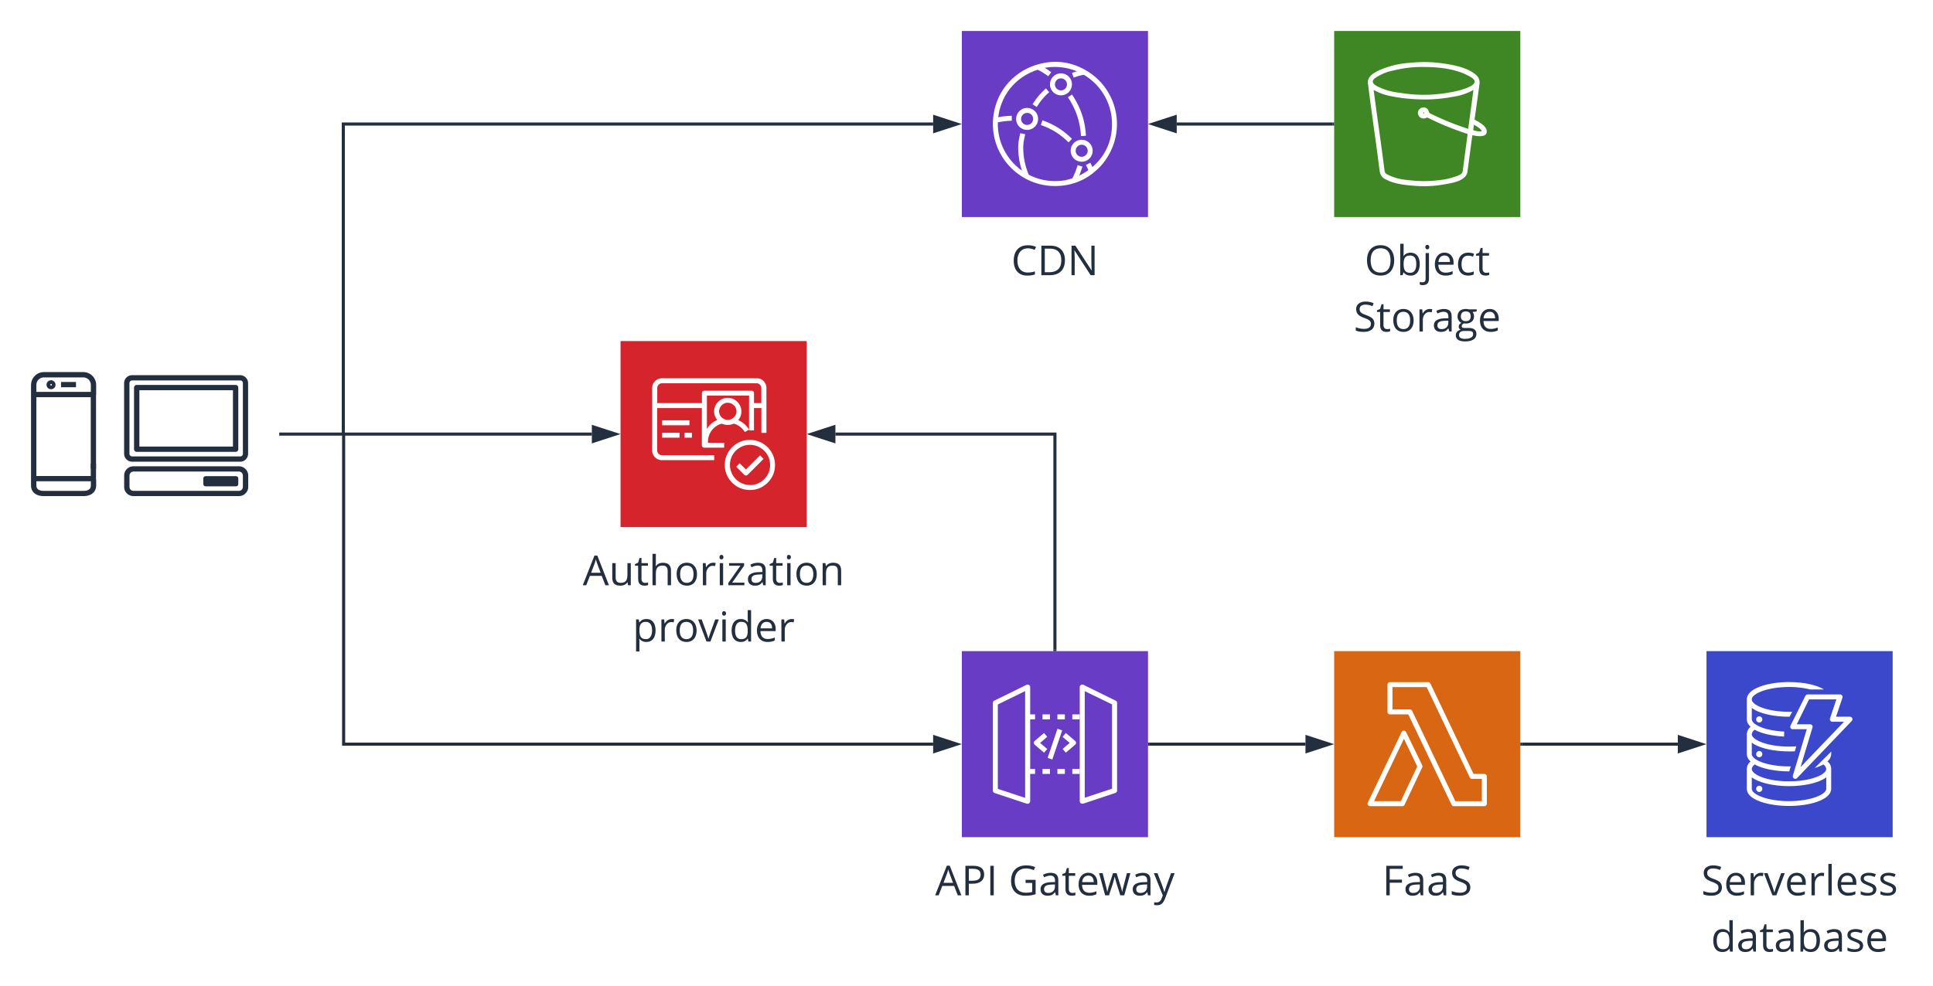
WEB APP/API
Notes:
browser gets static content from CDN
CDN uses Object Storage as a distribution source
for dynamic content, browser makes requests to API Gateway, which calls AWS Lambda.
Lambda works with state stored in serverless database
Authorization service is used to guard access to API Gateway

Slide 31
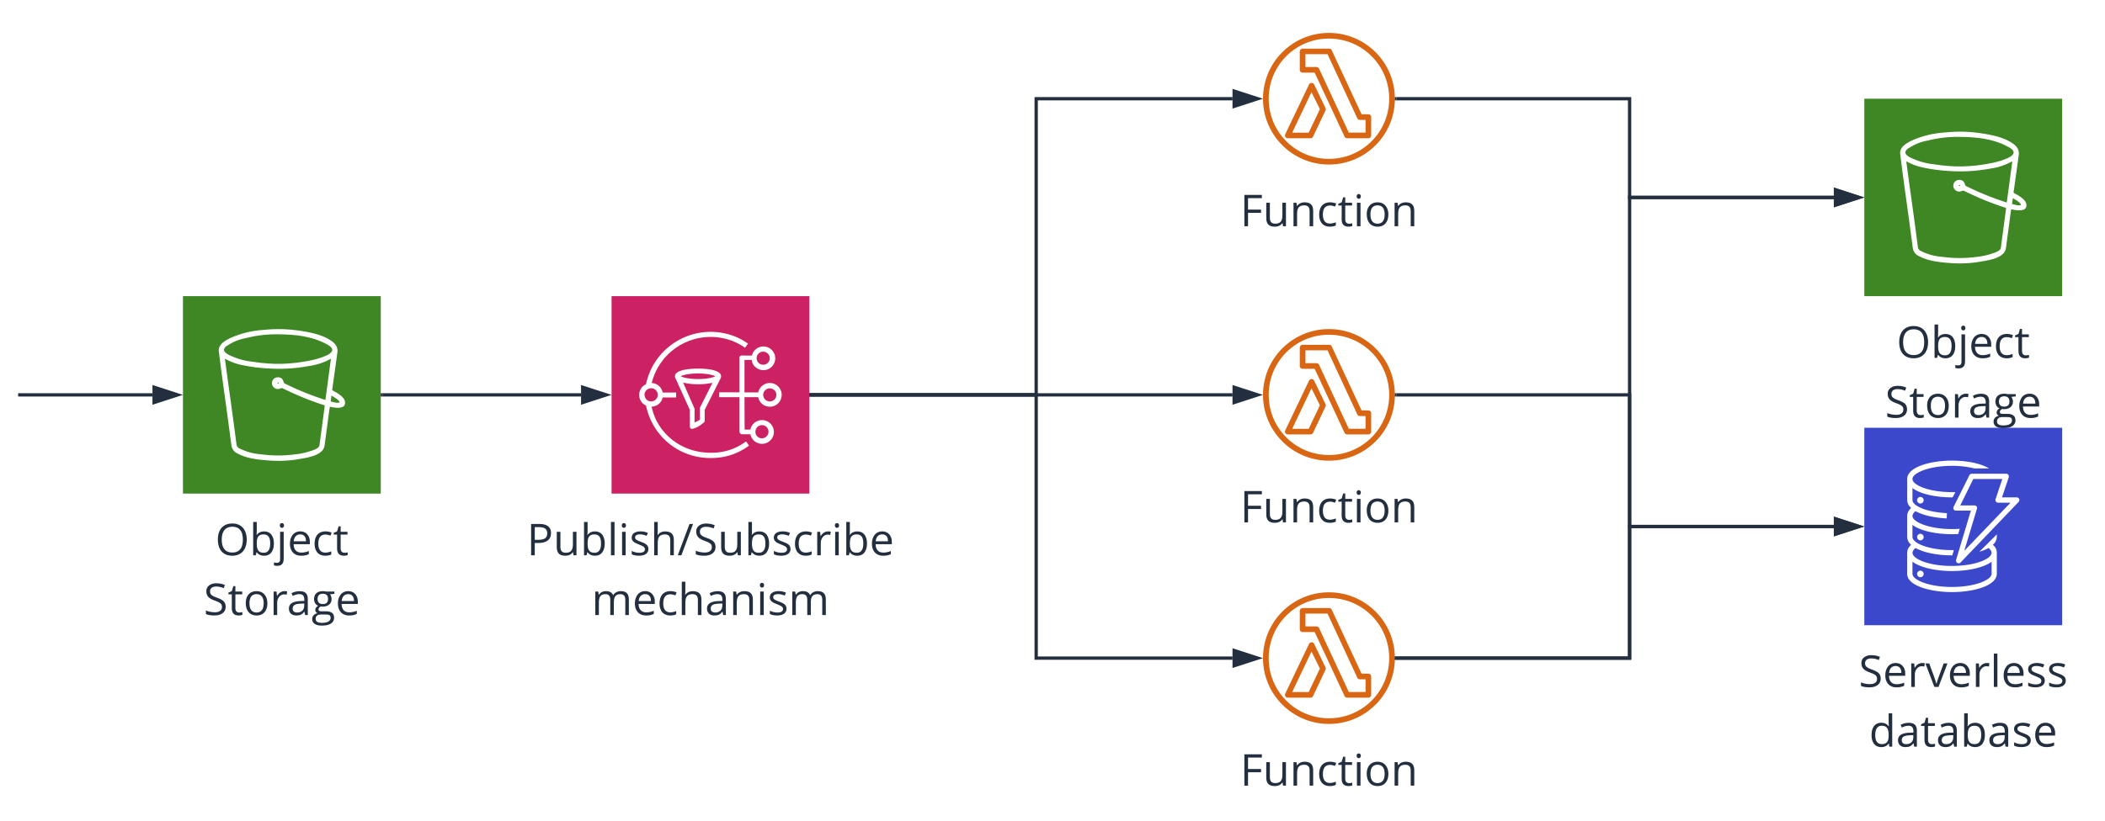
OBJECT/FILE PROCESSING
Notes:
near real-time
source
https://s3.amazonaws.com/awslambda-reference-architectures/file-processing/lambda-refarch-fileprocessing.pdf
https://github.com/aws-samples/lambda-refarch-fileprocessing
Objects are uploaded into storage
Storage pushes event to messaging
Messaging fans out to FaaS (different functions for different purposes)
FaaS writes to object storage for cost-effectiveness or to database for further processing or low-latency querying

Slide 32
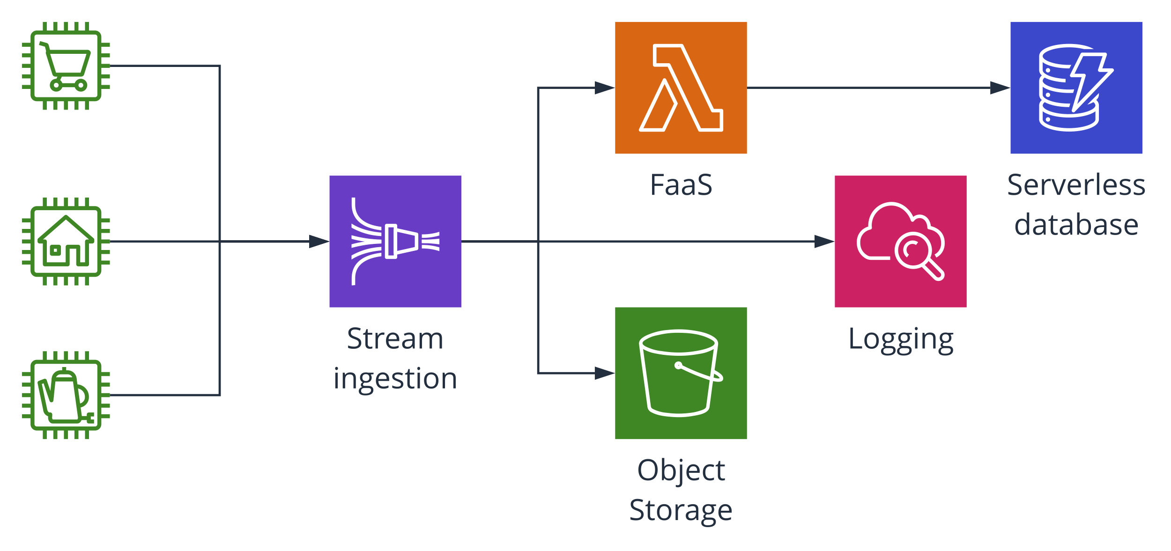
STREAM PROCESSING / IoT
Notes:
characteristics of stream processing application:
high ingest rate
near real-time processing (low latency)
spiky traffic (devices with intermittent network connections)
message durability
message ordering
clients could be – IoT devices
typical AWS ingestion: Kinesis ingests messages, can do transformations (with lambda), can batch records
Lambda could then put data in storage
Kinesis Firehose could also directly point to some storage (Like S3)
metrics are collected in CloudWatch

Slide 33
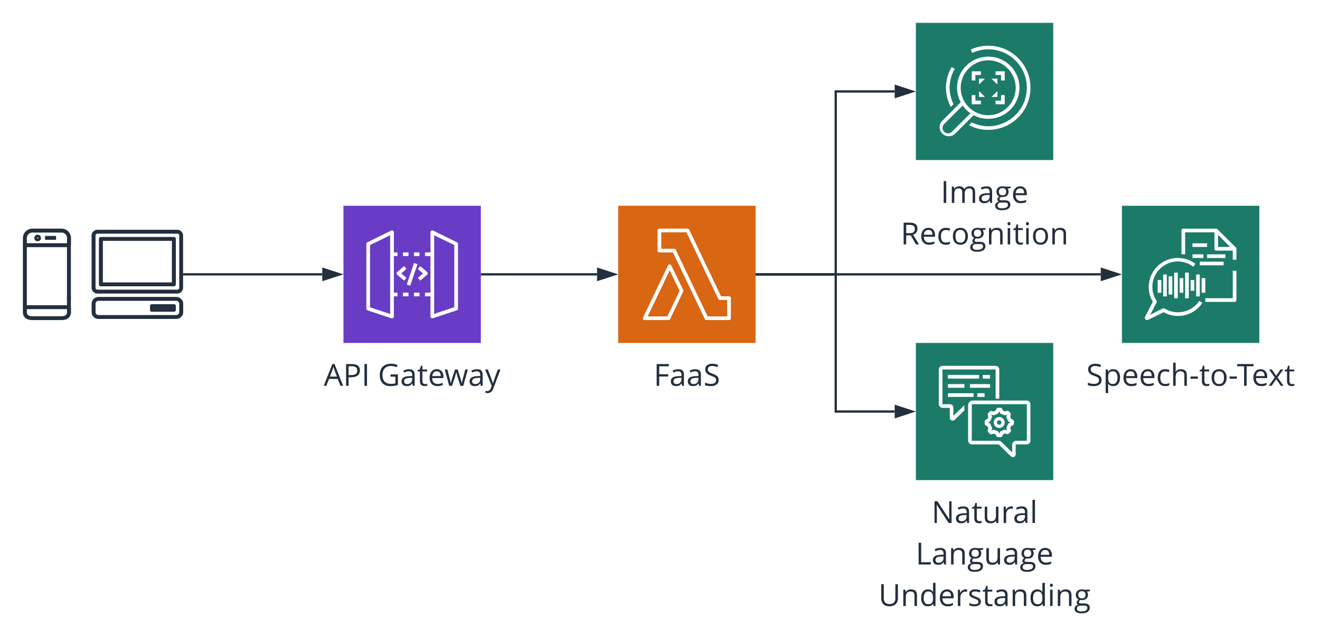
CHATBOTS / VIRTUAL ASSISTANTS
Notes:
https://github.com/aws-samples/lambda-refarch-image-moderation-chatbot
AWS:
Comprehend – natural language processing
Rekognition - image and video analysis
Polly – text to speech
Lex – speech to text, natural language understanding
Transcribe – speech recognition

Slide 34
PLAYERS

Slide 35
AMAZON WEB SERVICES
FaaS:
good language support
development tooling
big community support
Storage:
NoSQL
SQL
object
Services:
stream processing
managed queue and notifications
Speech, language and text processing
Media processing
Data analytics
IoT related

Slide 36
MICROSOFT AZURE
FaaS:
good language support
best debugging and local development capabilities
Storage:
NoSQL
SQL
object
Services:
stream processing
managed queue and notifications
Speech, language and text processing
Media processing
Data analytics
IoT related
Notes:
Second biggest

Slide 37
GOOGLE CLOUD PLATFORM
FaaS:
less developed
experiments with Cloud Run (beta)
Storage:
NoSQL – one of the best
SQL
object
Services:
stream processing
managed queue and notifications
Speech, language and text processing
Media processing
Data analytics
IoT related
Notes:
Third player among big cloud providers

Slide 38
Alibaba Cloud Function Compute
Triggers: API Gateway, streaming, IoT, HTTP, object storage, scheduled, message broker, NoSQL, relational database, CDN events, logs
Languages: Node.js, Python, Java, PHP, C#
Does not resolve dependencies – requires ready-to-run code
Notes:
smaller limits (100 concurrent executions - soft, 600s max duration)
billing – per request + duration + public network traffic
documentation is inconsistent
Languages: Node.js (6.10 and 8.9), Python (2.7 and 3.6), Java 1.8, PHP 7.2, C# (.NET Core 2.1)

Slide 39
IBM CLOUD
Lags behind.
IBM Cloud Functions – based on open-source Apache OpenWhisk platform.
Supports out of the box: nodeJS, Go, Swift, Python, Ruby, PHP, Java, .NET Core.
Also has event streaming, push notifications, storage.
Notes:
Provider lags behind AWS and Azure in capabilities.
IBM Cloud Functions – based on Apache OpenWhisk. Under the hood: Docker, Nginx, Kafka, CouchDB
limits: https://cloud.ibm.com/docs/openwhisk?topic=cloud-functions-openwhisk_reference#openwhisk_syslimits
10 min max. max 1k per namespace (soft limit)
Can run on: schedule, Cloudant db change feed, IBM Event Streams, Push Notifications service activity, GitHub, custom.
Supports out of the box: nodeJS, Go, Swift, Python, Ruby, PHP, Java, .NET Core.
Also supports custom Docker image based on image from Docker Hub.
There was an IBM Bluemix, a PaaS developed by IBM based upon open-source Cloud Foundry developed by VMware.
Went Generally Available in 2014.
Later was merged into IBM Cloud.

Slide 40
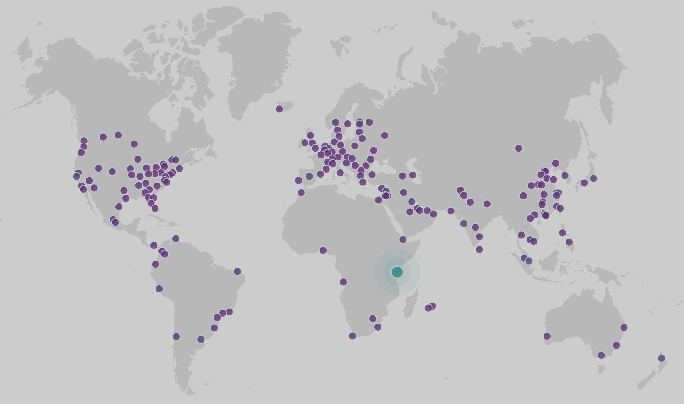
Notes:
CloudFlare – 180 datacenters around the world. Provide content delivery network services, DDoS mitigation, security, load balancing, distributed DNS.
They run super-fast functions on their edge locations (close to user), limited functionality and integrations though
Features:
Run in high performance V8 engine, not containers (so JavaScript, obviously)
Deployed to 180 Cloudflare datacenters
has fast key-value storage built in
fast startup time at all locations
support WebAssembly (currently they support Rust, expect C, C++, Go)
Cold starts: typically under 200ms. V8 instance spins up in under 5ms usually.
Source: https://blog.cloudflare.com/serverless-performance-comparison-workers-lambda/
cost $0.50 per million requests, with a $5 monthly min
User case: meddle with request and response. This can include:
load balancing
HTML rendering
caching
fan-out
custom security
data validation
hotfixes for your site
Limits: 5 to 50 ms CPU time, 128MB RAM.
No max concurrent limit.

Slide 41

Functions
Notes:
Spotinst: specializes in in utilizing Cloud Excess Capacity (Spot instances in AWS, Low-priority VMs in Azure, Preemptible VMs in GCP)
Uses machine learning to predict spot instances usage.
Main products:
elastigroup
manage spot instances fleet on behalf of you. Specific set of features and tight integration with each of the cloud vendors (AWS, Azure, GCP)
Ocean
managed engine that abstracts management of working nodes in Kubernetes cluster.
Automatically ensures the cluster is running on best possible mix of Spot, Reserved and On-Demand instances - optimizing for cost and performance.
Analogous to AWS Fargate, Azure Container Instances, GCP App Engine Flexible.
technically, you need to run Ocean’ controller pod in your cluster.
Functions
run your functions over resources managed by Spotinst.
Promises 50-80% cost savings in comparison with other providers.
Function integration capabilities: scheduler (cron) and HTTP call.
uses serverless framework for deployment. Supports node, Java, Python, Ruby, Go
in general, documentation is scarce, total impression is that this is not very mature.
Pricing – they demand for 20% of monthly savings in Professional plan and do not disclose Enterprise plan.

Slide 42
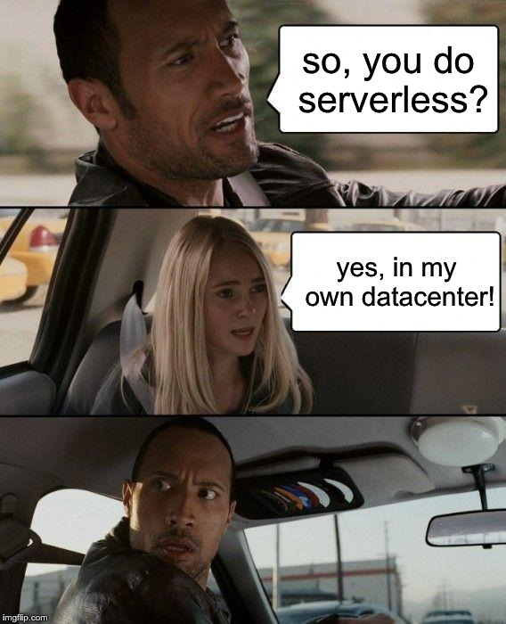
Notes:
Platforms!
all of them are free and open source,
all based on containers
All – 4k stars on Github if not mentioned else

Slide 43

PROJECT
supported by community
Kubernetes-based
Runtimes: Python, Node.js, Ruby, PHP, Go, .NET Core, Java, Ballerina, custom
Docker-based (you manage and configure fn servers)
Managed by Oracle currently
Notes:
fn Project – former IronFunctions

Slide 44


developed by Platform9 and OSS community
Kubernetes-based
Python, Node.js, Go, .NET, PHP, Ruby, Perl, Binary + any custom container
Can scale to 0 or ensure low latency (cold starts 100ms typically)
Good documentation
IBM runs it as IBM Cloud Functions
Kubernetes-based (Can also be deployed on: Mesos, OpenShift, bare VMs)
Python, Node.js, Swift, Go, Java, Scala, PHP, Ruby, Ballerina, custom

Slide 45
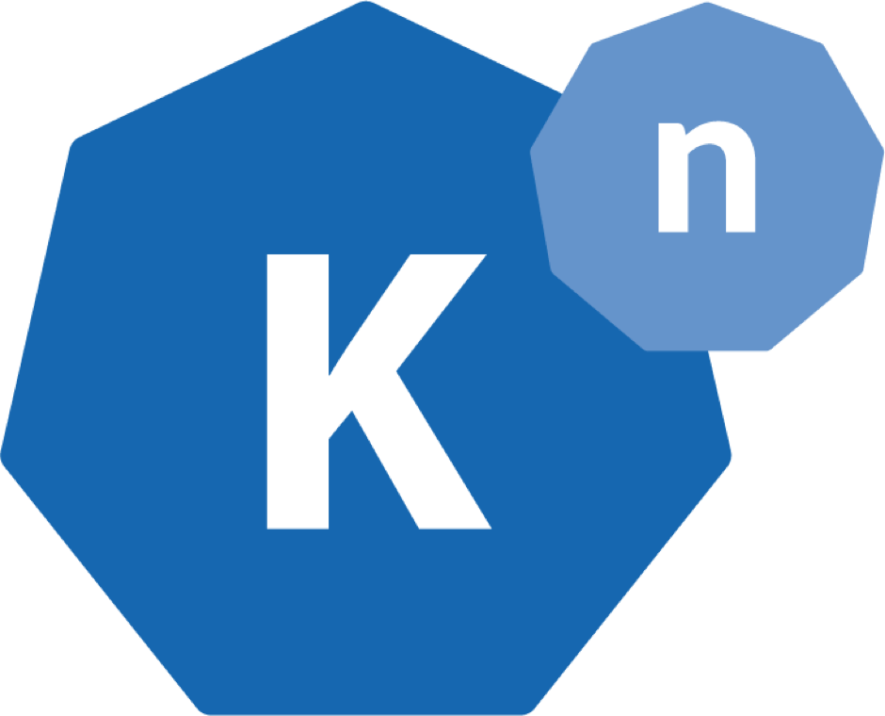

Knative
Created and supported by Google, IBM, RedHat, Pivotal contribute
Kubernetes-based
Google’s Cloud Run (in Beta), IBM’s Managed Knative (experimental)
Language agnostic
Is not production-ready but moves fast
developed by OSS community
runs on Kubernetes or Docker Swarm
language agnostic
Notes:
Knative, 2k stars on github
OpenFaaS - 14k stars on GitHub

Slide 46
ALSO, FRAMEWORKS!

Slide 47

most confusing name
free, open-source framework for building and deploying serverless applications
define your app in YAML and use CLI for deployment
one of the first serverless frameworks, strong community
has enterprise paid version with additional features
Notes:
one of the first of it’s kind, 29K stars on GitHub, strong community, a lot of plugins
first name was JAWS, it was targeting AWS only. Even today AWS support is one of the best.
AWS – CloudFormation, Azure – Resource Manager, GCP - Deployment Manager templates.
Apache OpenWhisk, Kubeless, Spotinst, fn, Cloudflare - API

Slide 48
AWS LAMBDA FRAMEWORKS
JAVA:
AWS Serverless Java container
for Python:
AWS Chalice
Zappa
for JavaScript:
AWS Serverless Express
Claudia.JS
Notes:
Frameworks to adopt serverless (AWS focused):
1. AWS Chalice, python serverless framework. CLI, API for integration with services, IAM policy generation
https://github.com/aws/chalice
Similar to them - https://github.com/Miserlou/Zappa, python, build and deploy
https://claudiajs.com/, node.js, automates deployment and integration
2. AWS Serverless Express
https://github.com/awslabs/aws-serverless-express run node.js Express apps
3. Sererless Java container
https://github.com/awslabs/aws-serverless-java-container
run Spring, Spring Boot, Apache Struts, Jersey or Spark in AWS Lambda

Slide 49
WHATS NEXT?

Slide 50
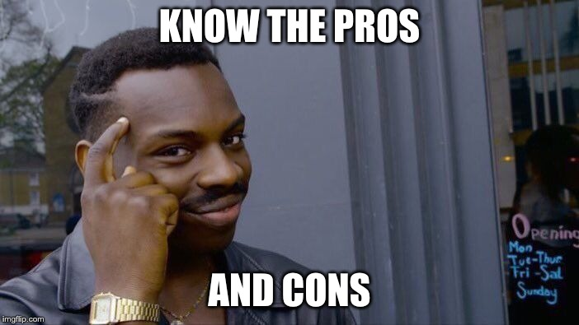

Slide 51

WHATS NEXT?

Slide 52
THANK YOU!

